Slide 1
UFHCC 2020 Research Day
Virtual Research Symposium Showcase

Slide 2
UFHCC 2020 Virtual Research Symposium
Format for Virtual Poster Session:
Pre-collegiate, undergraduate, graduate & post-doctoral poster presentations
Two 1-hour timeslots for presentations – pre-recorded videos with posters
Live poster judging via online comments/questions
Format for Virtual Award Presentations:
UFHCC Pre-doctoral Awardees 2019 & 2020
Introductions – Siemann
3MT video presentations
2020 Research Day Poster Award Winners
Announcement – Licht
3MT video presentations

Slide 3
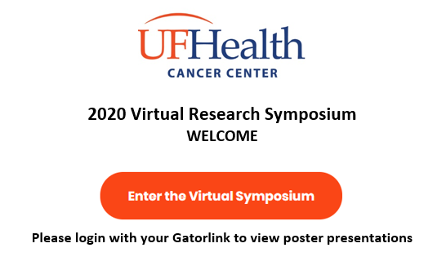
UFHCC 2020 Virtual Poster Session

Slide 4
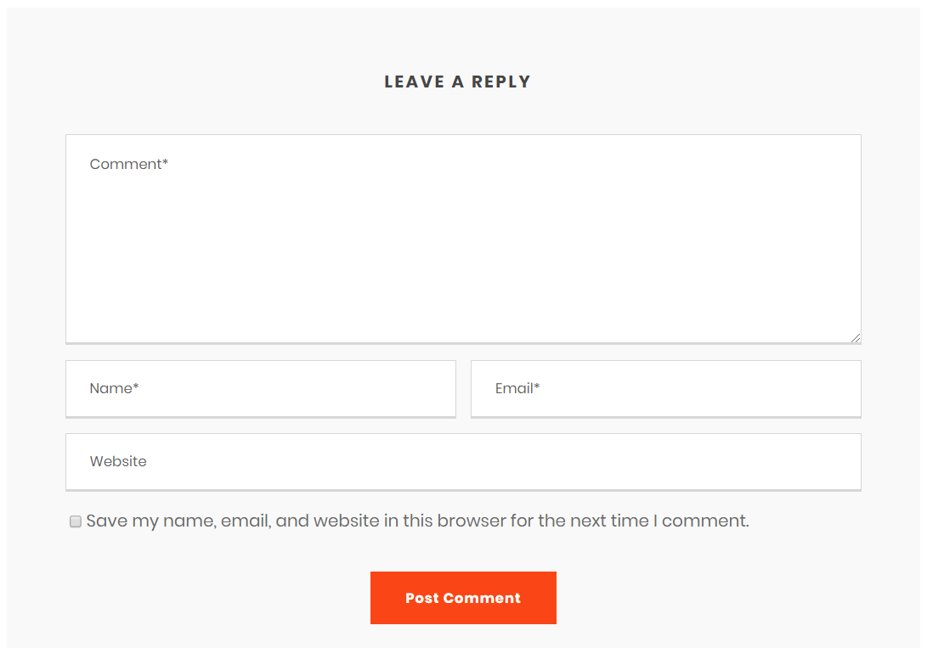
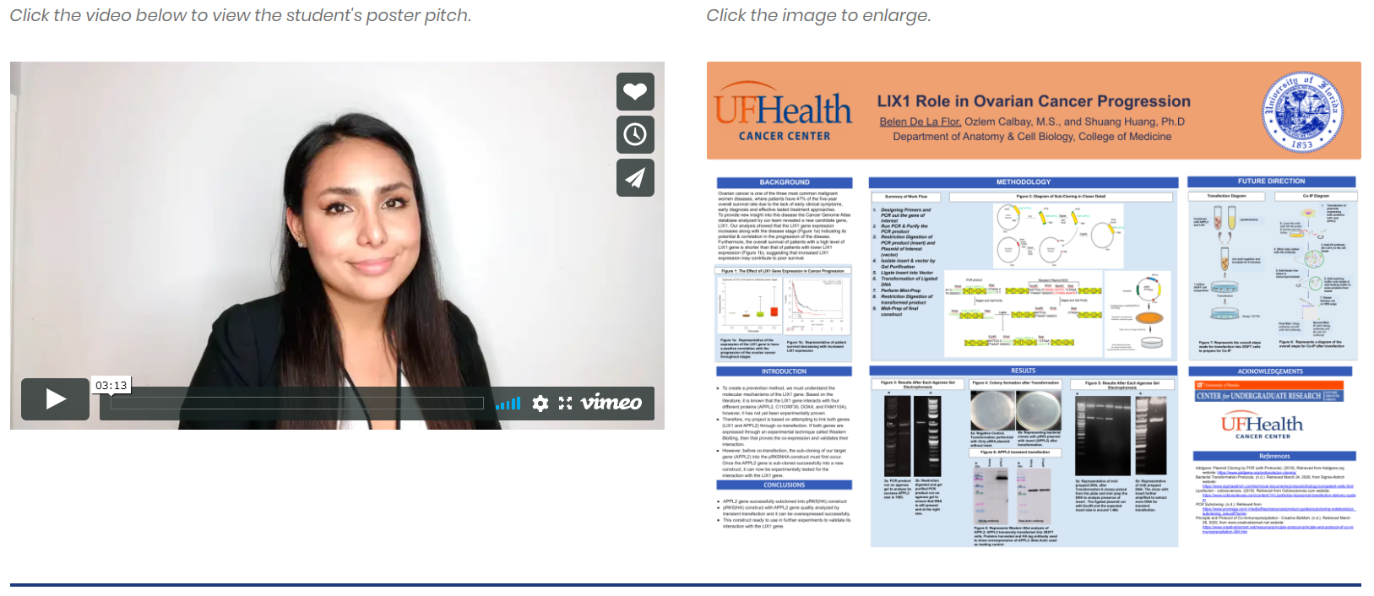
UFHCC 2020 Virtual Poster Session
Poster Presenter Template
Trainee Name
Academic Rank [Pre-collegiate, Undergraduate, Graduate, Post-doctoral]
Faculty Mentor
Poster Title
Authors
Poster #, Research Program
Research Keywords
Research Topic Keywords:
Poster presenters select up to 5 research topic keywords to describe the research focus of their poster

Slide 5
UFHCC 2020 Virtual Research Symposium
Format for Virtual Poster Session:
Pre-collegiate, undergraduate, graduate & post-doctoral poster presentations
Two 1-hour timeslots for presentations – pre-recorded videos with posters
Live poster judging via online comments/questions
Option 1 – Virtual Symposium
Mon/Tues: Virtual Poster Session
Wed: Special Virtual Grand Rounds – Celebrating the 2019/2020 Awardees
Format for Virtual Award Presentations:
UFHCC Pre-doctoral Awardees 2019 & 2020
Introductions – Siemann
3MT video presentations
2020 Research Day Poster Award Winners
Announcement – Licht
3MT video presentations
Option 2 – Virtual Symposium
Tues: Virtual Poster Session
Wed: Virtual Grand Rounds
& Meet the Professor Session
Thurs: Special Virtual Awards Session
Celebrating the 2019/2020 Awardees
Celebrating Awardees conflicts with Fall Grand Rounds Schedule

Slide 6
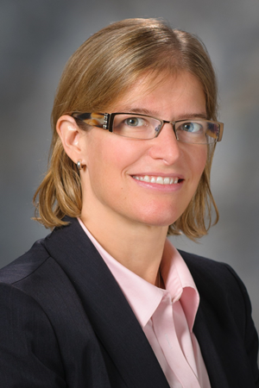
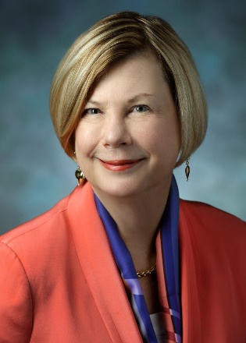
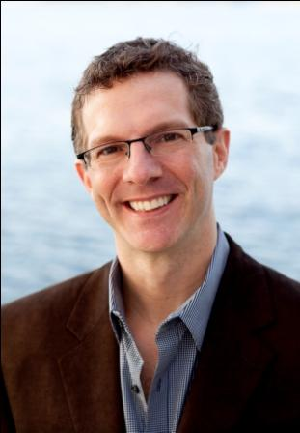
UFHCC 2020 Virtual Research Symposium
Date Option 1
Tues. 11/17/2020 – Virtual Poster Session
3:00-5:00 pm or 4:00-6:00 pm
Wed. 11/18/2020 – Virtual Grand Rounds & Virtual Meet the Professor Session
Jennifer A. Wargo, MD, MMSC
Professor, Surgical Oncology & Genomic Medicine
Program Director, Program for Innovative Microbiome & Translational Research (PRIME-TR)
MD Anderson Cancer Center
Thurs. 11/19/2020 – Special Research
Seminar: Celebrating our 2019-2020 Awardees
4:00-5:30 pm
Date Option 2
Tues. 12/1/2020 – Virtual Poster Session
3:00-5:00 pm or 4:00-6:00 pm
Wed. 12/2/2020 – Virtual Grand Rounds & Virtual Meet the Professor Session
Sandra M. Swain, MD
Associate Dean, Research Development
Professor of Medicine
Georgetown University Medical Center
Thurs. 12/3/2020 – Special Research
Seminar: Celebrating our 2019-2020 Awardees
4:00-5:30 pm
Date Option 3
Tues. 12/8/2020 – Virtual Poster Session
3:00-5:00 pm or 4:00-6:00 pm
Wed. 12/9/2020 – Virtual Grand Rounds &
Virtual Meet the Professor Session
Jesse Dallery, PhD (internal speaker)
Professor, Psychology
Area Director, Behavior Analysis Program
College of Liberal Arts & Sciences
University of Florida
Thurs. 12/10/2020 – Special Research
Seminar: Celebrating our 2019-2020 Awardees
4:00-5:30 pm
Virtual Poster Session conflicts with JDL LLS SCOR Site Visit
Conflicts with ASH Annual Meeting scheduled for Dec. 5-8, 2020

Slide 8
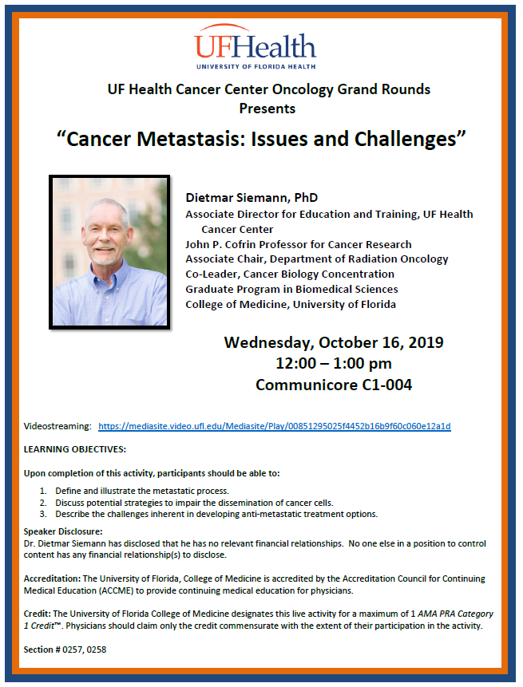
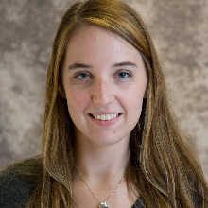
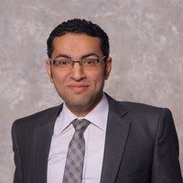
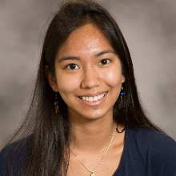
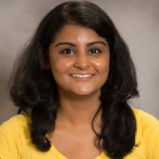
UFHCC Special Research Seminar: Celebrating our 2019-2020 Awardees
UFHCC Pre-doctoral Awardees 2019
Bayli DiVita Dean
Biomedical Sciences Program – Immunology & Microbiology
Mentor: Catherine Flores, PhD
Dissertation Title: “Elucidating the role of gliomas on hematopoietic cells”
UFHCC Pre-doctoral Awardees 2019
Abdelrahman Elsayed
Clinical Pharmaceutical Sciences Program
Mentor: Jatinder Lamba, PhD
Dissertation Title: “Genome Wide and Targeted Approaches to Identify Biomarkers Associated with Clinical Outcomes in Pediatric AML Patients”
UFHCC Pre-doctoral Awardees 2020
TBD
Adaixa Padron (NCI F31 CA247421)
Clinical Health Psychology Program
Mentor: Deidre Pereira, PhD
Dissertation Title: “Diurnal Variations in Salivary Concentrations of Pro-Tumorigenic Cytokines and Possible Effects of Psycho-Physiological Stress in Oncology Patients and Matched Healthy Controls”
Mai Tanaka
Biomedical Sciences Program – Cancer Biology
Mentor: Dietmar Siemann, PhD
Dissertation Title: “Multimodal roles of Axl in Cancer Metastasis”
Kartika Venugopal
Biomedical Sciences Program – Cancer Biology
Mentor: Olga Guryanova, MD, PhD
Dissertation Title: “Leukemia-associated DNMT3A mutant cells are more sensitive to replication stalling pharmacological agents”
2020 Virtual Research Symposium Poster Winners
TBD
Date TBD
Time TBD
Videostreaming: Link

